Slide 1
Medical Logistics
Lt Col Adam G. Henson, MSC, FACHE
NATO UNCLASSIFIED

Slide 2

Overview
AJP 4.6. JLSG (How medical fits in)
AJMed P-1, Joint Medical Planning Doctrine
AJMed P-4, Joint Doctrine for Medical Support
AJMed P-2, Joint Medical Doctrine for MEDEVAC
NATO UNCLASSIFIED

Slide 3
AJP 4.6- JLSG

Slide 4
JLSG C2
NATO UNCLASSIFIED

Slide 5
JLSG C2
Medical Branch:
The medical branch is responsible for the coordination of medical support functions
and elements assigned to COM JLSG and for the integration with the overall C2 structure
In theatre. The senior medical officer of the medical branch acts as the medical advisor
(MEDAD) to COM JLSG.
NATO UNCLASSIFIED

Slide 6
JLSG C2
NATO UNCLASSIFIED

Slide 7
AJP 4.6- JLSG
Medical Support in NATO is, in principle a national responsibility
However, COM JTF shares the responsibility for medical support of multinational forces
JLSG HQ is deployed = medical representation is key
Medical C2 Structure
Patient Evacuation
Medical input to RSOM
Medical re-supply
MEDAD will have direct access to COM JLSG
NATO UNCLASSIFIED

Slide 8
AJP 4.6- JLSG Responsibilities
Medical Branch
Provide medical advice to COM JLSG
Short term planning
Exchange of information (theatre wide), GO, NGOs, IOs
Medical Reporting System
Medical Support to RSOM&I
C2 of Medical Treatment Facilities assigned to JLSG
Coordinating Medical Logistics
Patient Evacuation
PECC- Patient Evacuation Coordination Center
NATO UNCLASSIFIED

Slide 9

AJMed P-1, Joint Medical Planning

Slide 10
AJMed P-1
The guiding principle for medical logistics is that it is a national responsibility
However, multinational solutions may offer efficiencies for the medical supply chain
Due to technical complexity and legal requirements medical logistics factors require full analysis
Blood products
Special handling requirements (pharmaceuticals, gas, etc.)
Prioritization of delivery
Mortuary affairs
Disposal of clinical waste (medical & radiological)
Water, Food, Power
NATO UNCLASSIFIED

Slide 11

AJMed P-4, Medical Support

Slide 12
AJMed P-4 (Slide 1 of 2)
The responsibility for planning & executing medical logistics is shared by the medical & logistics staff
Compliance with Good Distribution Practice (GDP) which is an internationally accepted standard
Interoperability
Property exchange or replacement of medical non-expendable items
Medical supplies- handling instructions (expiration, storage, etc.)
Identification of content (syringes, containers, etc.) STANAG
Medical supplies
Protected under the terms of the Geneva Conventions*
Regulatory aspects
Handling requirements
Importance
NATO UNCLASSIFIED

Slide 13
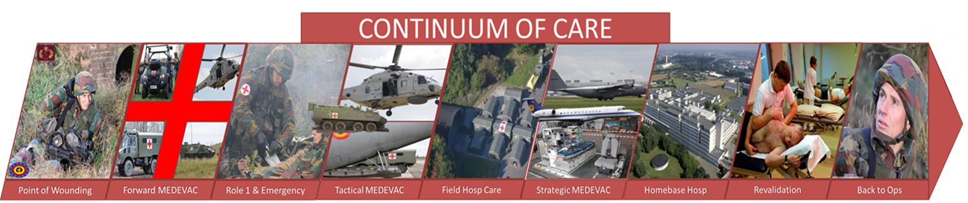
AJMed P-4 (slide 2 of 2)
First Aid & Emergency Medical Care Equipment
Blood & Blood products
Stretchers, Litters
Medical Gases
Medical Waste
Medical Stockpile Planning
AJMed P-2, Medical Evacuation
Ground, Air, Maritime assets
Special challenges for logistics?
NATO UNCLASSIFIED

Slide 14
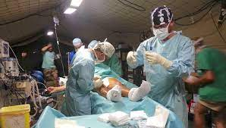
Review
AJP 4.6. JLSG (How medical fits in)
AJMed P-1, Joint Medical Planning Doctrine
AJMed P-4, Joint Doctrine for Medical Support
AJMed P-2, Joint Medical Doctrine for MEDEVAC
NATO UNCLASSIFIED

Slide 15
NATO UNCLASSIFIED

